Slide 1

Object Detection
Topic:
Presented to:
Prof. Alessandro Giuseppi &
Prof. Luca Benvenuti
By:
Shahkar Javid
Matricola: 2047305
S M Syed Shaihan
Matricola: 2048059
MSc in Artificial Intelligence and Robotics

Slide 2
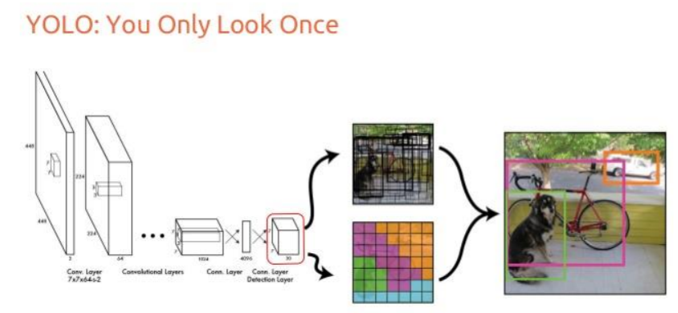
Object Detection Models
Sliding Window Object Detection
R-CNN
Fast R CNN
YOLO
Faster R CNN

Slide 3
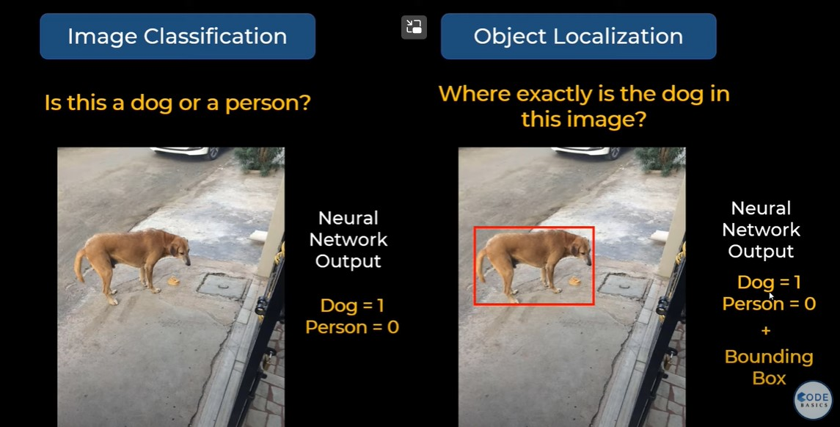
Detection Procedure
Before going into details of yolo, lets discuss how general object localization work
Here we not only want to classify an object but also detect it.
Classification is easy but how to detect an object using a bounding box?

Slide 4
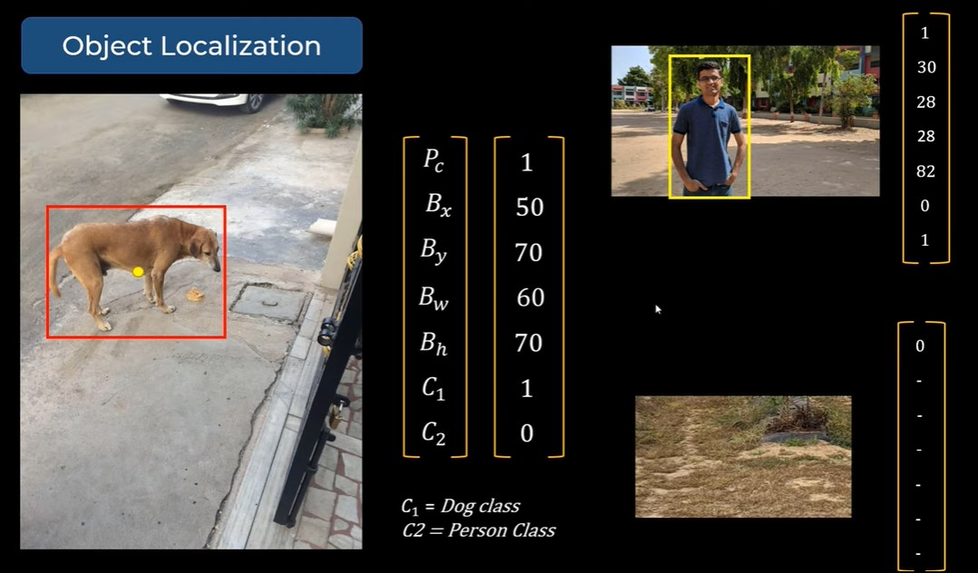
Detection Procedure
For each detection we need a vector containing the confidence score, coordinates of the bounding box (x,y,h,w), and number of classes (one hot encoded)
This vector will be used during training as well as during prediction.

Slide 5
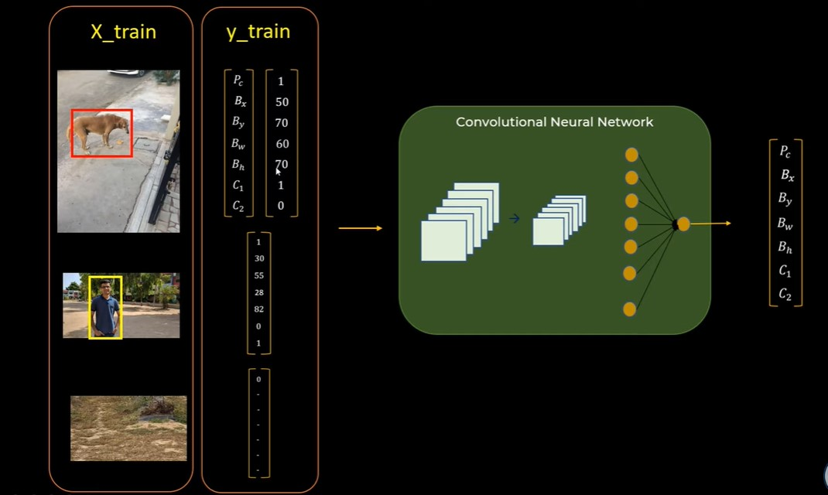
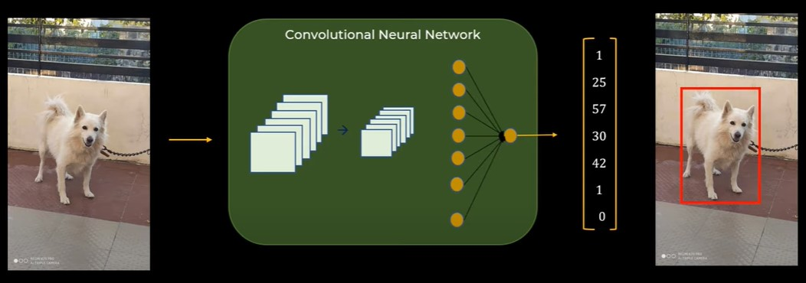
Detection Procedure

Slide 6

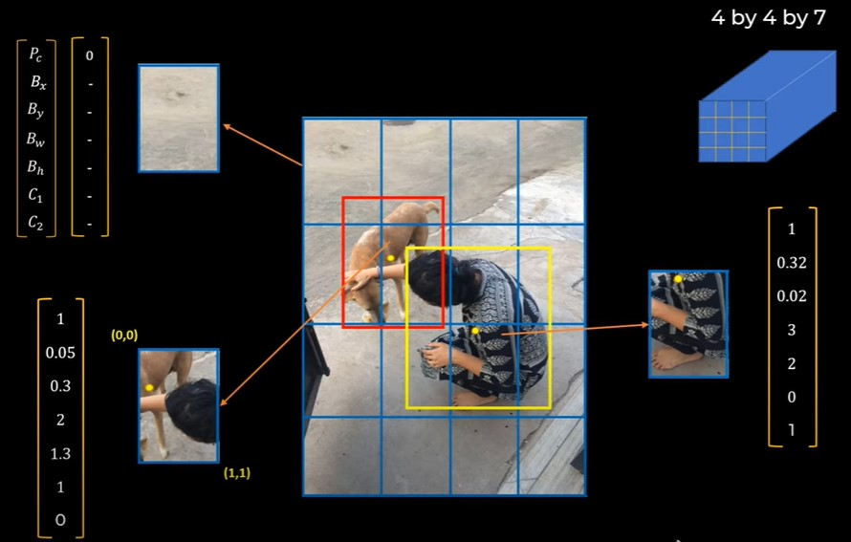
We split the image into an S*S grid (here for explanation we consider 4x4 grids) Each cell predicts boxes(x,y,w,h) and confidences of each box.
Multiple Objects Detection Using YOLO
Each grid cell then checks if it contains (part of) a known object and which class the object belongs to. If an object is present, the cell draws possible bounding boxes around it.

Slide 7
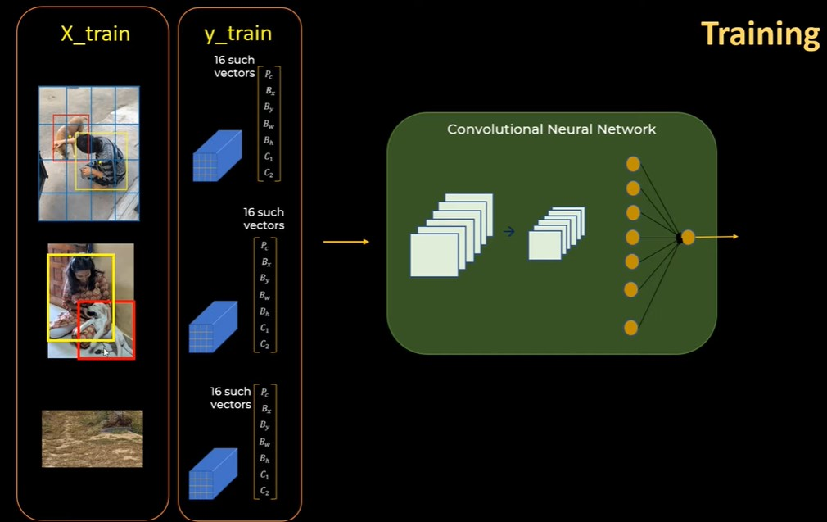
Training Dataset
For training we need annotated images with bounding boxes coordinate of each class in an image Labelimg was used for annotating images of my task.
https://github.com/heartexlabs/labelImg

Slide 8
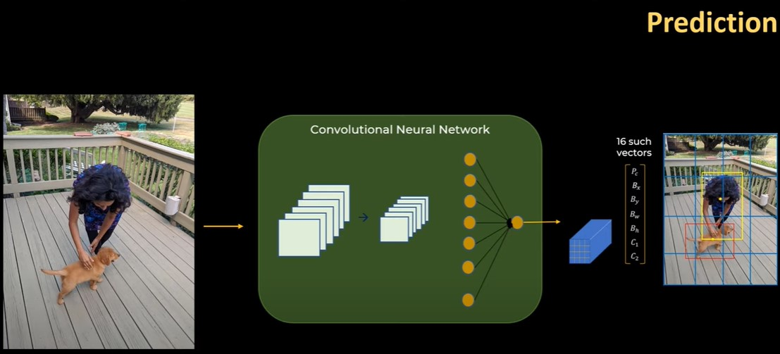
After Training for adequate amount of epoch, if we feed an image to model it should detect and classify object as below;

Slide 9
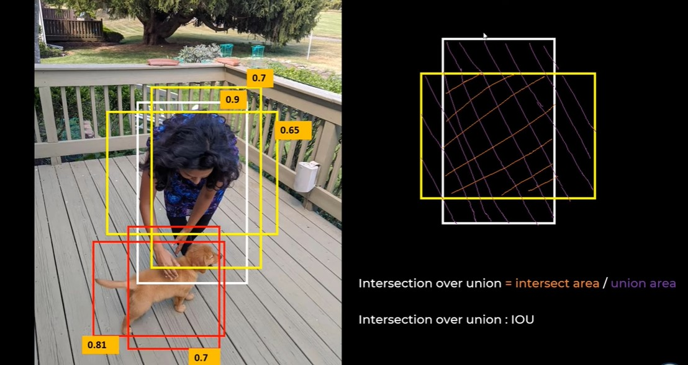
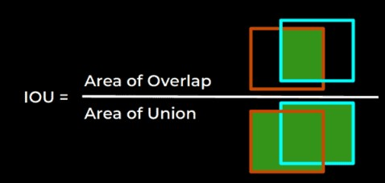
Intersection Over Union (IoU) is a number that quantifies the degree of overlap between two boxes. In this case of object detection, IoU evaluates the overlap of the Ground Truth(white) and Predictions region

Slide 10
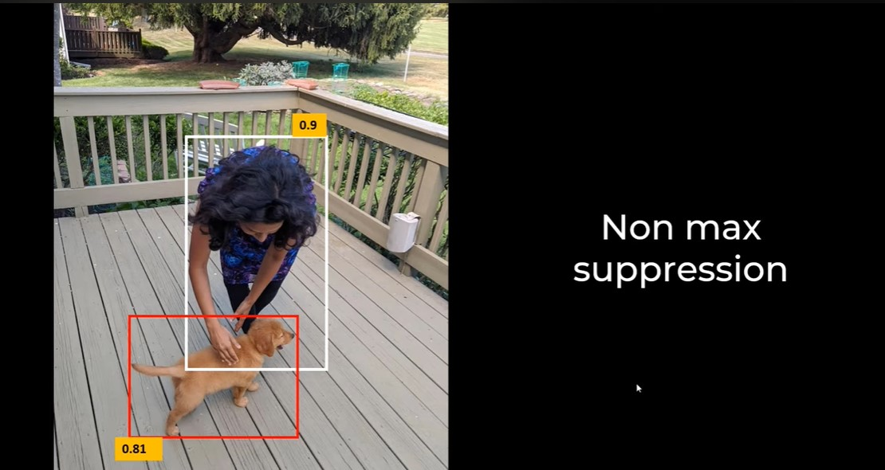
Non Maximum Suppression is a technique that selects a single entity out of many overlapping entities (for example bounding boxes in object detection). The criteria is usually discarding entities that are below a given threshold bound.
For example; if the threshold value of IoU is kept at 0.5 (hyper parameter). Non max suppression technique will discard all the bounding boxes that are below or equal to that range.

Slide 11
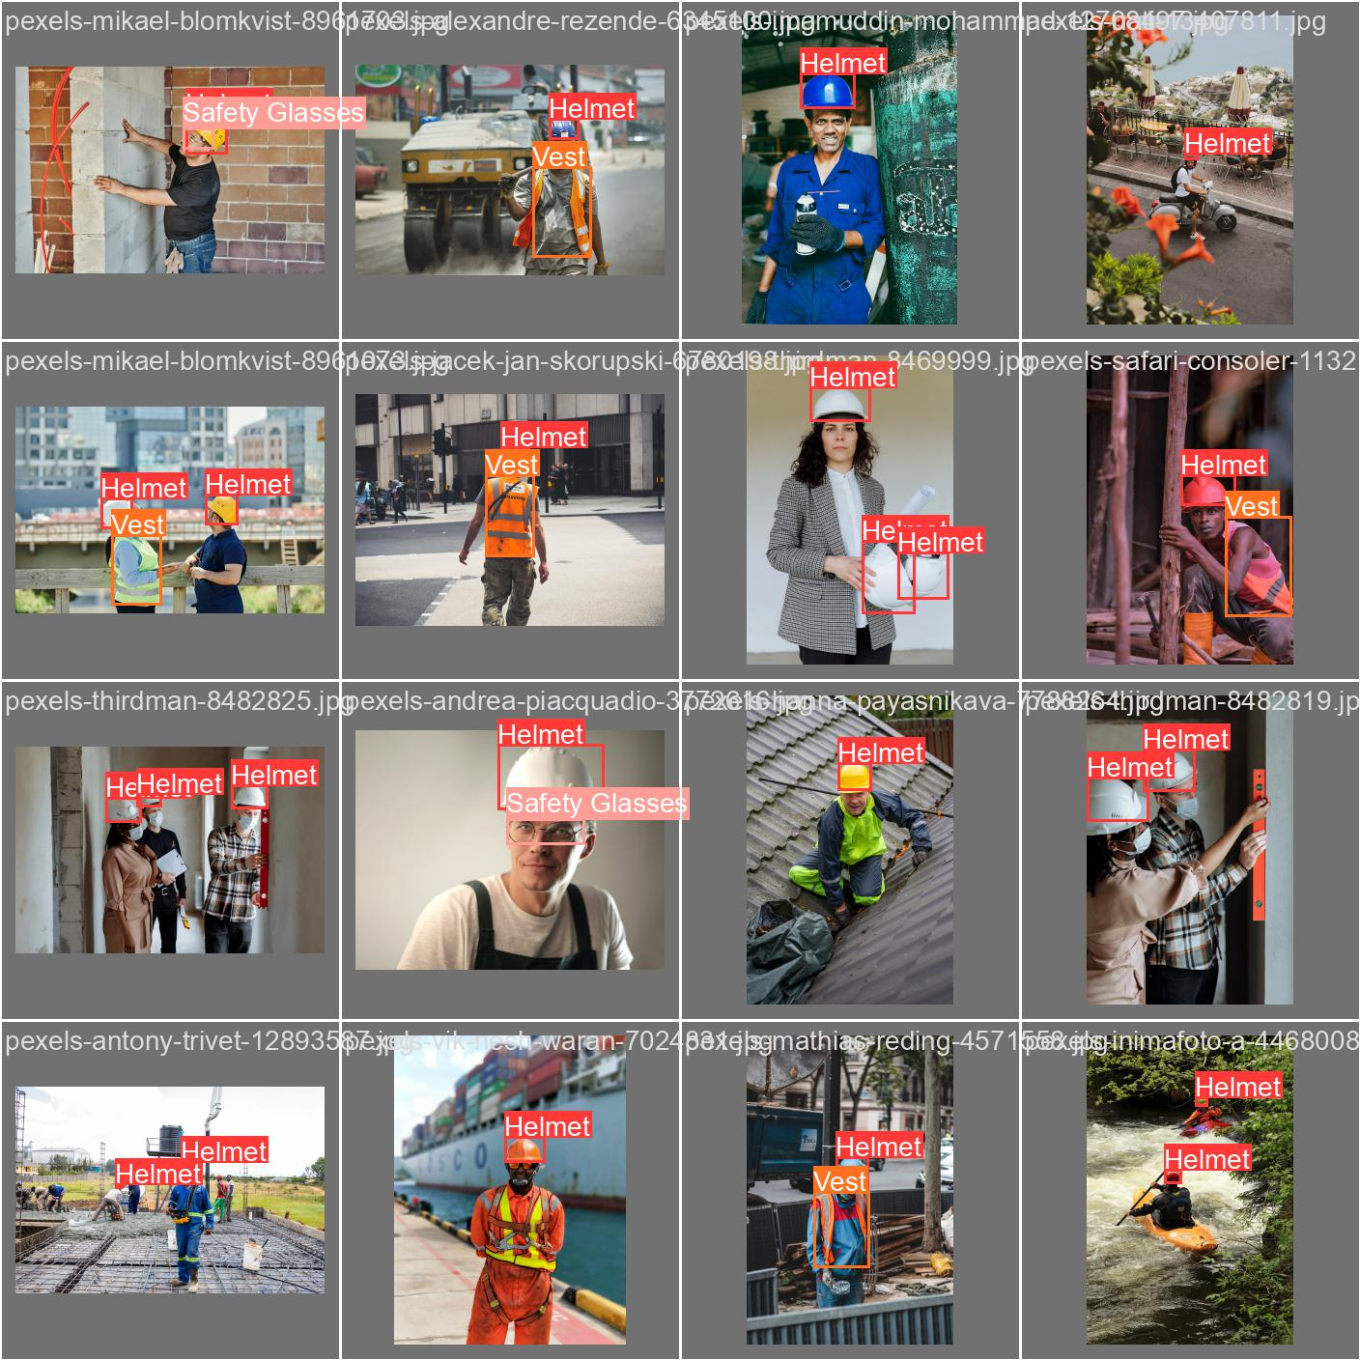
Here I trained YOLO model for three classes i.e. helmet, safety glasses, and safety vest for 100 epoch, and result is quite acceptable. I test it on video as well as on image.

Slide 12
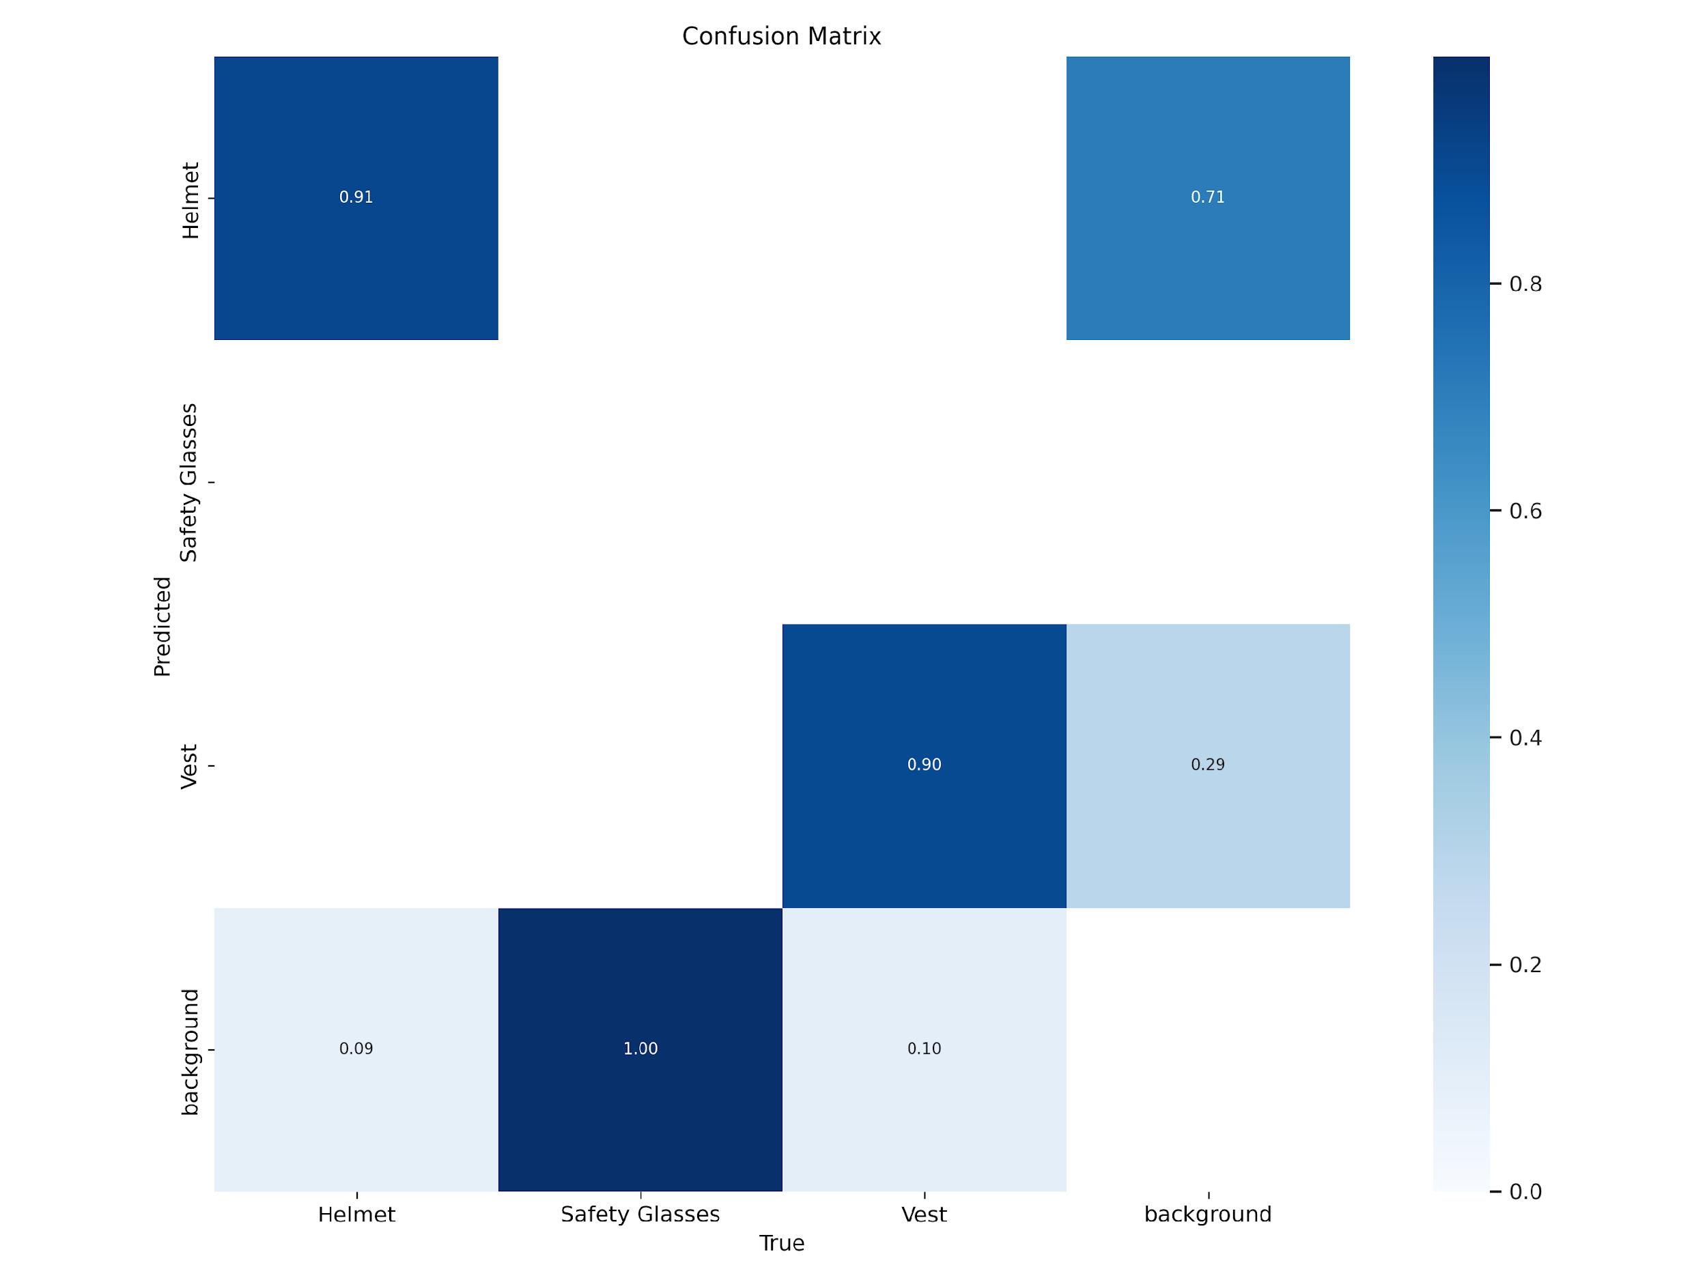
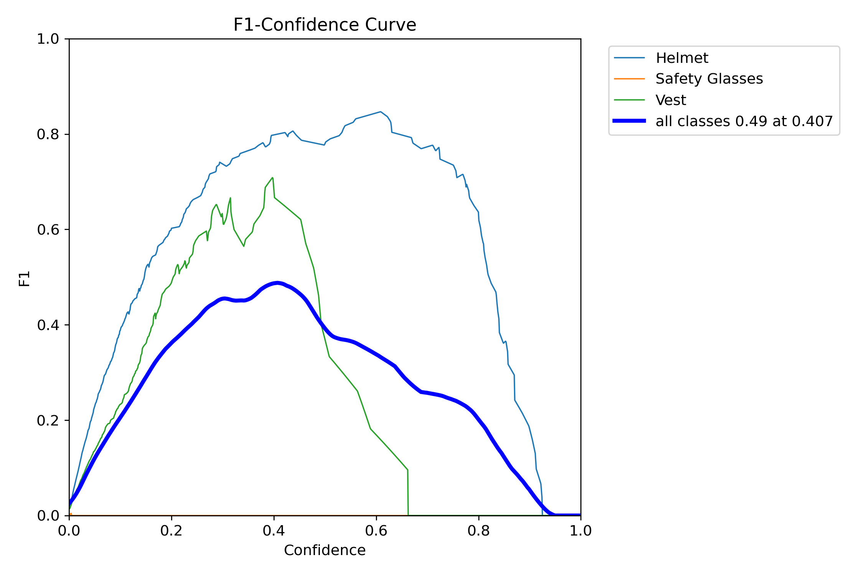
In F1 confidence curve we can see that category of safety glasses weren’t as much detected as other classes. The only reason is because of the dataset and annotation. We do not have the enough dataset for safety glasses

Slide 13
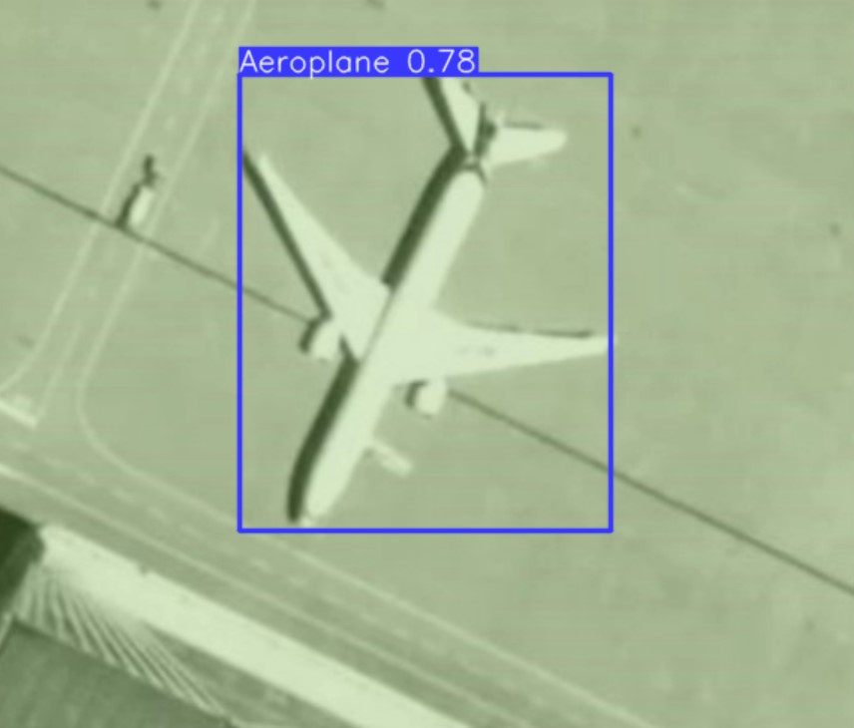
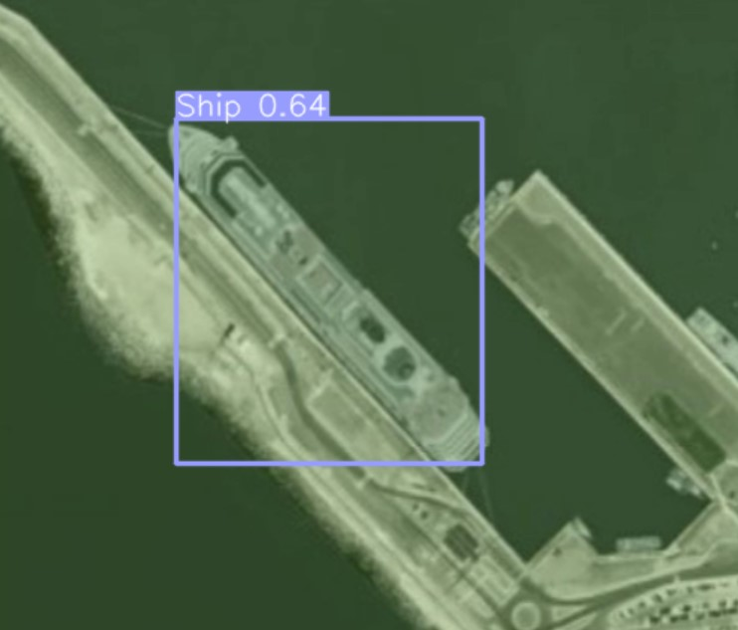
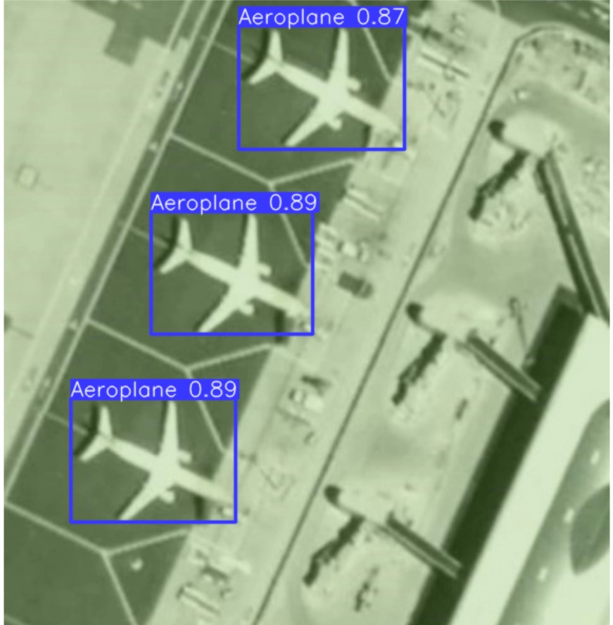
Detection of Object from Satellite Images

Slide 14
Limitation of YOLO Architecture
Since each grid has to decide whether it contains an object or not, very small objects may not be recognized as distinct from the rest of the image at all.
Each grid can only contain a small number of objects, so if there are several objects close together, it may only recognize one of them.
Despite these disadvantages, YOLO is a compelling object detection system due to its speed and the fact that it sacrifices very little accuracy in return. It does a great job even with fast-moving video files

Slide 15
Applications of Object Detection
There are countless application nowadays of object detection some of them are mentioned below.
Autonomous Driving: The invention of object detection is what has allowed self-driving cars to function on roads. Vehicles rely on this technology to inform them when pedestrians are crossing and when other cars are nearby.
Counts the Number of People/Cars/traffic: Unless you have someone willing to sit and count every person/car that is in a space, you can never know for certain the number of of dynamic objects. The crowd counting feature can be helpful if you work in law enforcement and you need to control theme parks, concerts, and other big venues.
Healthcare Medical Detection: Healthcare organizations can also benefit from object detection. As many medical diagnostics require images to study, scans for patients and other photographs this technology is a breakthrough.
Inventory Management: Object detection applications trained to identify every item in a store’s inventory can instantly alert employees when items need to be restocked.
Anomaly and Defect Detection: Object detection can identify parts and finished products that don’t meet quality standards.
And Many more………….

Slide 16
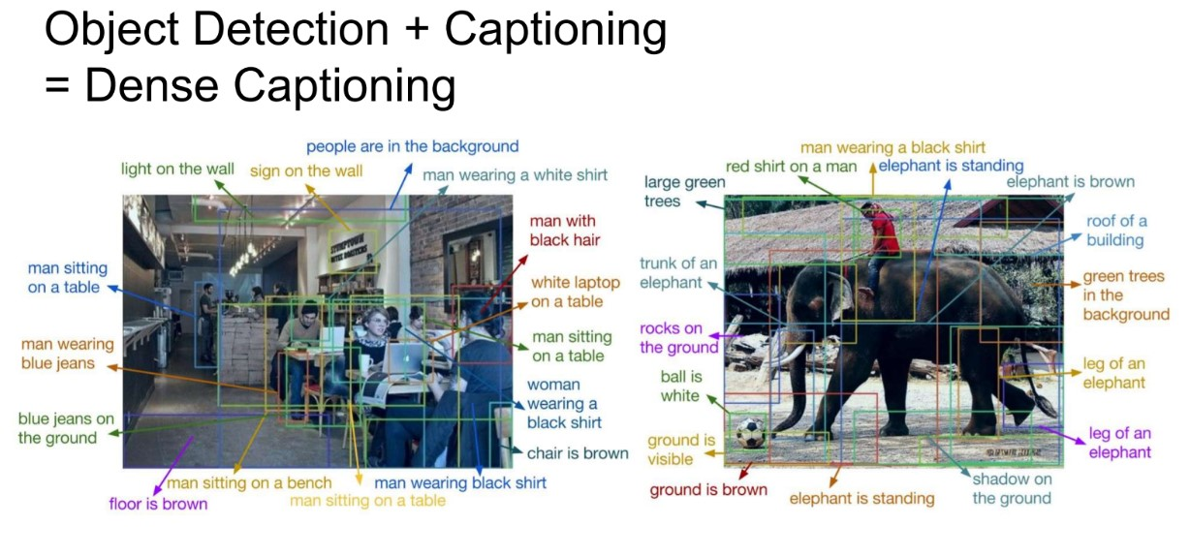
Further extension of this task

Slide 17
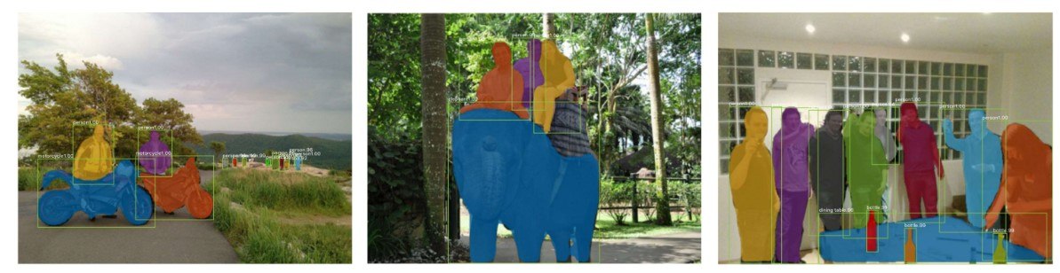
Further extension of this task
Instance Segmentation and Object Detection

Slide 18


